Slide 1
STATUS REPORT: WEEK: 03
Md. Zillur Rahman • 12.11.2019
S. M. Foysal Ahmed • 12.11.2019

Slide 2
Overview
Expected delivery
December 19, 2019
Recent progress
Working Platforms Sign up
Environment Set Up
The First chunk of Code

Slide 3
Progress - Detect Face
It can detect any face in the stream
Makes a rectangular marker

Slide 4
Progress - Identify Face
It Identifies face
Makes a rectangular marker and print the name

Slide 5
Progress - Identify Multiple Faces
It can Identify multiple faces from the stream
Makes a rectangular marker each of face

Slide 6
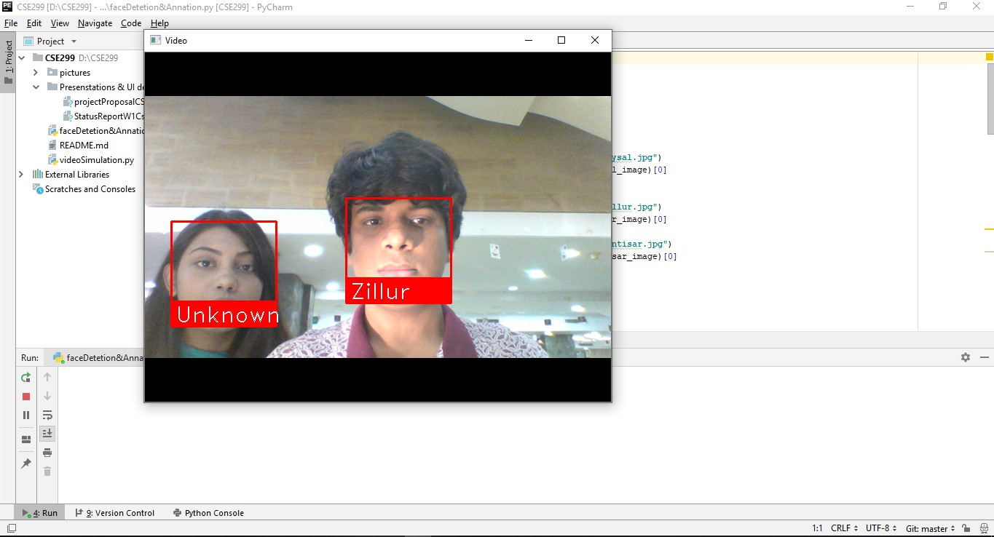

Slide 7
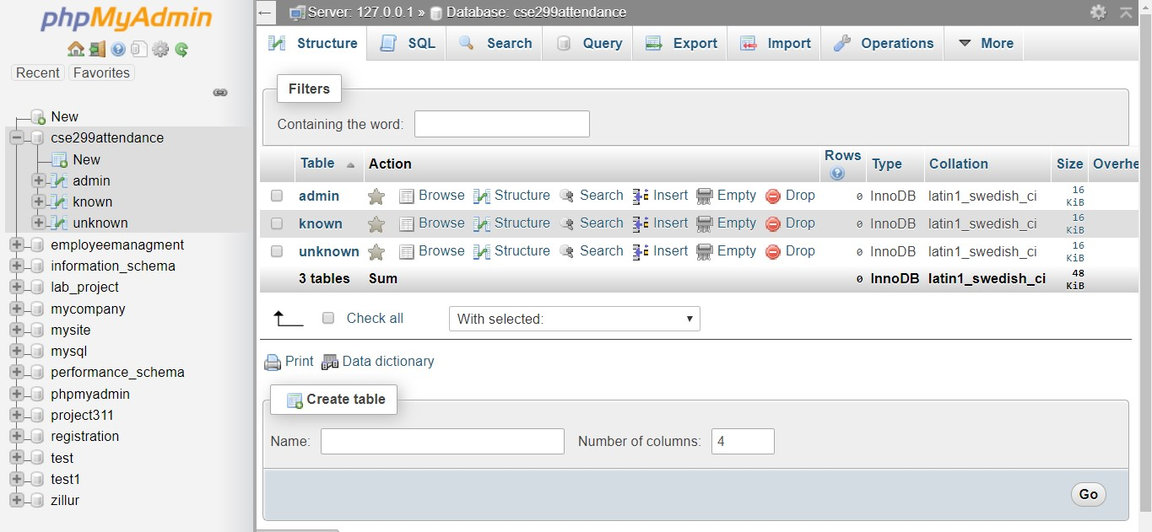

Slide 8
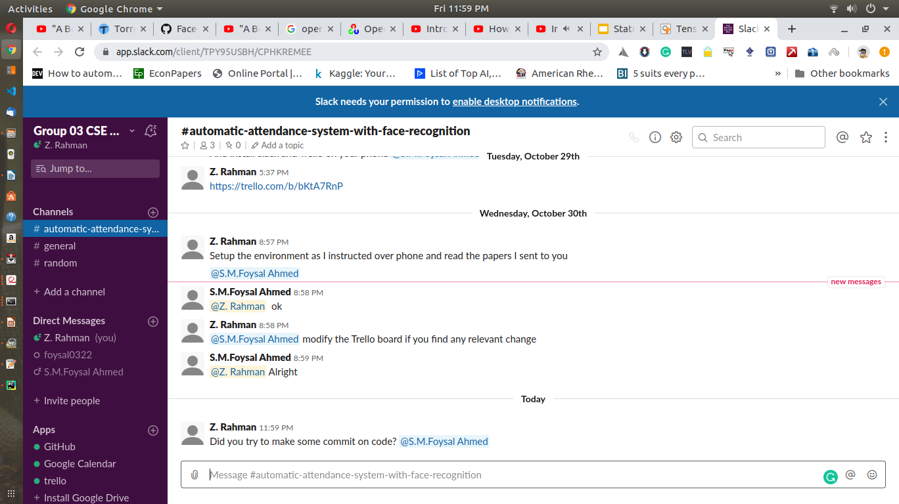

Slide 9
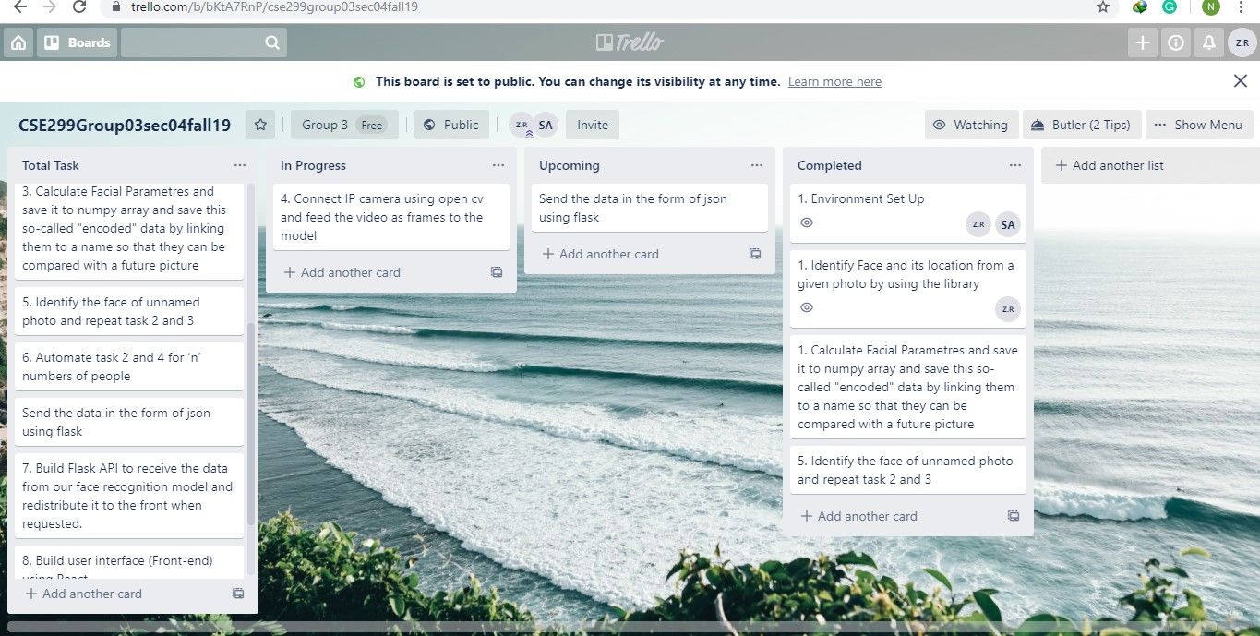

Slide 10
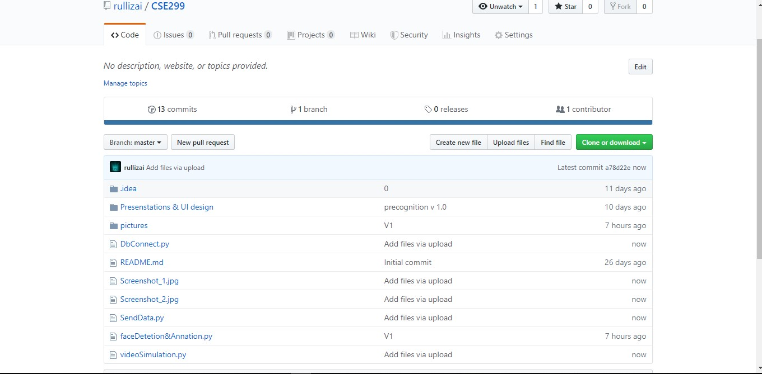
Progress - Database creation
Mysql database has been created
Connection established

Slide 11
What happened in week 2
It was supposed implement the face detection and location in week 2
But stuck badly; there was no progress in code segment
IP camera didn't connect
This week work accelerated heavily
But still ip camera issue was not solved

Slide 12
Goals for next week
Send the data to database using Flask and Json
UI design for web View
IP camera issue

